Slide 1
UNIX -2
By Suraj Yadav

Slide 2
Unix System Structure
user
c programs scripts
ls ksh
gcc find
shell and utilities
open() fork() exec()
kernel
hardware

Slide 3
Kernel Subsystems
File system
Deals with all input and output
Includes files and terminals
Integration of storage devices
Process management
Deals with programs and program interaction
How processes share CPU, memory and signals
Scheduling
Interprocess Communication
Memory management
UNIX variants have different implementations of different subsystems.

Slide 4
Want to learn file commands
Search for Text file -2 FILE COMMANDS

Slide 5

What is a shell?
The user interface to the operating system
Functionality:
Execute other programs
Manage files
Manage processes
A program like any other
Executed when you log on

Slide 6
Most Commonly Used Shells
/bin/sh The Bourne Shell / POSIX shell
/bin/csh C shell
/bin/tcsh Enhanced C Shell
/bin/ksh Korn shell
/bin/bash Free ksh clone
Basic form of shell:
while (read command) { parse command execute command }

Slide 7
Shell Interactive Use
When you log in, you interactively use the shell:
Command history
Command line editing
File expansion (tab completion)
Command expansion
Key bindings
Spelling correction
Job control

Slide 8

Shell Scripting
A set of shell commands that constitute an executable program
A shell script is a regular text file that contains shell or UNIX commands
Very useful for automating repetitive task and administrative tools and for storing commands for later execution

Slide 9
Simple Commands
simple command: sequence of non blanks arguments separated by blanks or tabs.
1st argument (numbered zero) usually specifies the name of the command to be executed.
Any remaining arguments:
Are passed as arguments to that command.
Arguments may be filenames, pathnames, directories or special options (up to command)
Special characters are interpreted by shell

Slide 10
A simple example
$ ls –l /bin -rwxr-xr-x 1 root sys 43234 Sep 26 2001 date $
prompt
command
arguments
Execute a basic command
Parsing into command in arguments is called splitting

Slide 11
Getting Help on UNIX
man: display entries from UNIX online documentation
whatis, apropos
Manual entries organization:
1. Commands
2. System calls
3. Subroutines
4. Special files
5. File format and conventions
6. Games
http://en.wikipedia.org/wiki/Unix_manual

Slide 12
Example Man Page
ls ( 1 )
USER COMMANDS
ls ( 1 )
NAME
ls - list files and/or directories
SYNOPSIS
ls [ options ] [ file ... ]
DESCRIPTION
For each directory argument ls lists the contents; for each file argument the name and requested information are listed. The current directory is listed if no file arguments appear. The listing is sorted by file name by default, except that file arguments are listed before directories.
.
OPTIONS
-a, --all
List entries starting with .; turns off --almost-all.
-F, --classify
Append a character for typing each entry.
-l, --long|verbose
Use a long listing format.
-r, --reverse
Reverse order while sorting.
-R, --recursive
List subdirectories recursively.
SEE ALSO
chmod(1), find(1), getconf(1), tw(1)

Slide 13
Today
Discuss several commands relating to:
Security
File system
Like (security) read(r) Write(w) and x is for?

Slide 14



Fundamentals of Security
UNIX systems have one or more users, identified with a number and name.
A set of users can form a group. A user can be a member of multiple groups.
A special user (id 0, name root) has complete control.
Each user has a primary (default) group.

Slide 15
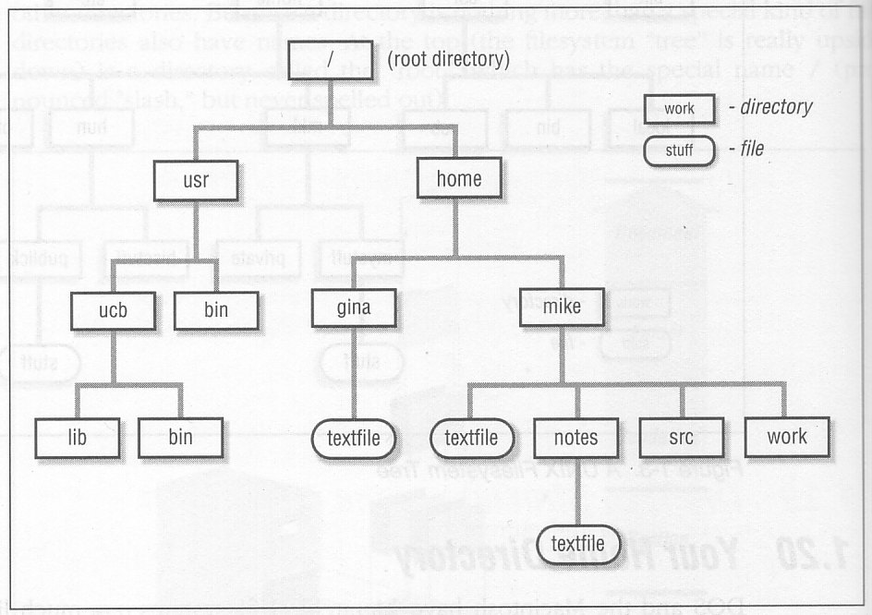
The UNIX File Hierarchy

Slide 16
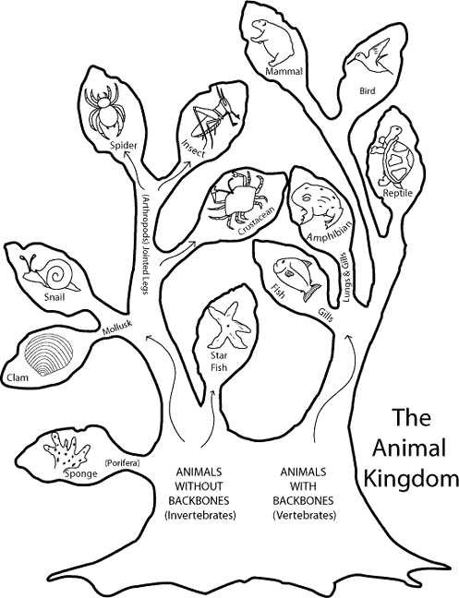
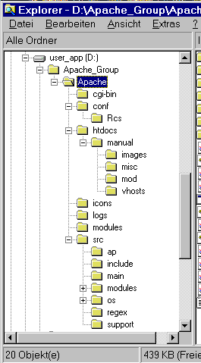
Hierarchies are Ubiquitous

Slide 17
Definition: Filename
A sequence of characters other than slash. Case sensitive.
/
usr
tmp
etc
bin
foo
who
date
dmr
wm4
foo
who date .profile
.profile

Slide 18
Definition: Pathname
A sequence of directory names followed by a simple filename, each separated from the previous one by a /
/
usr
tmp
etc
bin
foo
who
date
dmr
wm4
/usr/wm4/.profile
.profile

Slide 19
Definition: Working Directory
A directory that file names refer to by default.
One per process.
/
usr
tmp
etc
bin
foo
who
date
dmr
wm4
.profile

Slide 20
Definition: Relative Pathname
A pathname relative to the working directory (as opposed to absolute pathname)
/
usr
tmp
etc
bin
foo
who
date
dmr
wm4
.. refers to parent directory . refers to current directory
.profile
.profile ./.profile ../wm4/.profile

Slide 21
Files and Directories
Files are just a sequence of bytes
No file types (data vs. executable)
No sections
Example of UNIX philosophy
Directories are a list of files and status of the files:
Creation date
Attributes
etc.

Slide 22
Tilde Expansion
Each user has a home directory
Some shells (ksh, csh) support ~ operator:
~ expands to my home directory
~/myfile → /home/kornj/myfile
~user expands to user’s home directory
~unixtool/file2 → /home/unixtool/file2
Useful because home directory locations vary by machine

Slide 23
Printing File Contents
The cat command copies the contents of a file to the terminal. When invoked with a list of file names, it concatenates them.
Some options:
-n number output lines (starting from 1)
-v display control-characters in visible form (e.g. ^C)
Interactive commands more and less show a page at a time

Slide 24
Common Utilities for Managing files and directories
pwd print process working dir
ed, vi, emacs… create/edit files
ls list contents of directory
rm remove file
mv rename file
cp copy a file
touch create an empty file or update
mkdir and rmdir create and remove dir
wc counts the words in a file
file determine file contents
du directory usage

Slide 25
File Permissions
UNIX also provides a way to protect files based on users and groups.
Three types of permissions:
read, process may read contents of file
write, process may write contents of file
execute, process may execute file
Three sets of permissions:
permissions for owner
permissions for group
permissions for other

Slide 26
Directory permissions
Same types and sets of permissions as for files
read: process may a read the directory contents (i.e., list files)
write: process may add/remove files in the directory
execute: process may open files in directory or subdirectories

Slide 27
Utilities for Manipulating file attributes
chmod change file permissions
chown change file owner
chgrp change file group
only owner or super-user can change file attributes
upon creation, default permissions given to file modified by process umask value

Slide 28
Chmod command
Symbolic access modes {u,g,o} / {r,w,x}
example: chmod +r file
Octal access modes
octal read write execute
0 no no no
1 no no yes
2 no yes no
3 no yes yes
4 yes no no
5 yes no yes
6 yes yes no
7 yes yes yes

Slide 29
The Open File Table
I/O operations are done on files by first opening them, reading/writing/etc., then closing them.
The kernel maintains a global table containing information about each open file.
Inode
Mode
Count
Position
1023
read
1
0
1331
read/write
2
50
…

Slide 30
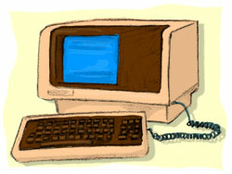
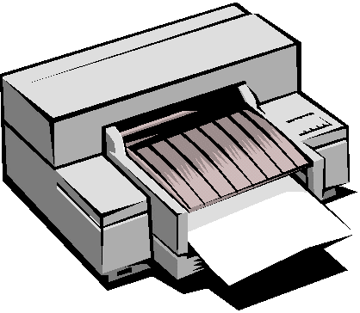
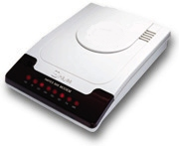
Devices
Besides files, input and output can go from/to various hardware devices
UNIX innovation: Treat these just like files!
/dev/tty, /dev/lpr, /dev/modem
By default, standard in/out/err opened with /dev/tty

Slide 31
Using Devices
Redirection works with devices (just like files)
Special files in /dev directory
Example: /dev/tty
Example: /dev/lp
Example: /dev/null
cat big_file > /dev/lp
cat big_file > /dev/null

Slide 32
Mounting File Systems
When UNIX is started, the directory hierarchy corresponds to the file system located on a single disk called the root device.
Mounting allows root to splice the root directory of a file system into the existing directory hierarchy.
File systems created on other devices can be attached to the original directory hierarchy using the mount mechanism.
Commands mount and umount manage

Slide 33
Mounting File Systems
root device
external device
/
/
a
a
b
b
/
Device
Mount Point
a
/
b
/a/b
a
Mount table
b

Slide 34

Links
Directories are a list of files and directories.
Each directory entry links to a file on the disk
Two different directory entries can link to the same file
In same directory or across different directories
Moving a file does not actually move any data around.
Creates link in new location
Deletes link in old location
ln command

Slide 35
Symbolic links
Symbolic links are different than regular links (often called hard links). Created with ln -s
Can be thought of as a directory entry that points to the name of another file.
Does not change link count for file
When original deleted, symbolic link remains
They exist because:
Hard links don’t work across file systems
Hard links only work for regular files, not directories
dirent
Contents of file
symlink
dirent
Contents of file
dirent
Hard link
Symbolic Link

Slide 36
Hard Link
usr tmp etc bin
foo
dmr wm4
who date
.profile
etc

Slide 37
Symbolic Link
usr tmp etc bin
foo
dmr wm4
who date
.profile
etc
/usr/wm4/.profile

Slide 38
find utility (continued)
-perm [+-]mode
Find files with given access mode, mode must be in octal. Eg: find . 755
-type ch
Find files of type ch (c=character, b=block, f for plain file, etc..). Eg: find /home –type f
-user userid/username
Find by owner userid or username
-group groupid/groupname
Find by group groupid or groupname
-size size
File size is at least size
many more…

Slide 39
find: logical operations
! expression returns the logical negation of expression
op1 -a op2 matches both patterns op1 and op2
op1 -o op2 matches either op1 or op2
( ) group expressions together

Slide 40
find: actions
-print prints out the name of the current file (default)
-exec cmd
Executes cmd, where cmd must be terminated by an escaped semicolon (\; or ';').
If you specify {} as a command line argument, it is replaced by the name of the current file just found.
exec executes cmd once per file.
Example:
find -name "*.o" -exec rm "{}" ";"

Slide 41
find Examples
Find all files beneath home directory beginning with f
find ~ -name 'f*' -print
Find all files beneath home directory modified in last day
find ~ -mtime 1 -print
Find all files beneath home directory larger than 10K
find ~ -size 10k -print
Count words in files under home directory
find ~ -exec wc -w {} \; -print
Remove core files
find / -name core –exec rm {} \;

Slide 42
diff: comparing two files
diff: compares two files and outputs a description of their differences
Usage: diff [options] file1 file2
-i: ignore case
apples oranges walnuts
apples oranges grapes
$ diff test1 test2 3c3 < walnuts --- > grapes

Slide 43
Other file comparison utilities
cmp
Tests two files for equality
If equal, nothing returned. If different, location of first differing byte returned
Faster than diff for checking equality
comm
Reads two files and outputs three columns:
Lines in first file only
Lines in second file only
Lines in both files
Must be sorted
Options: fields to suppress ( [-123] )

